Slide 1
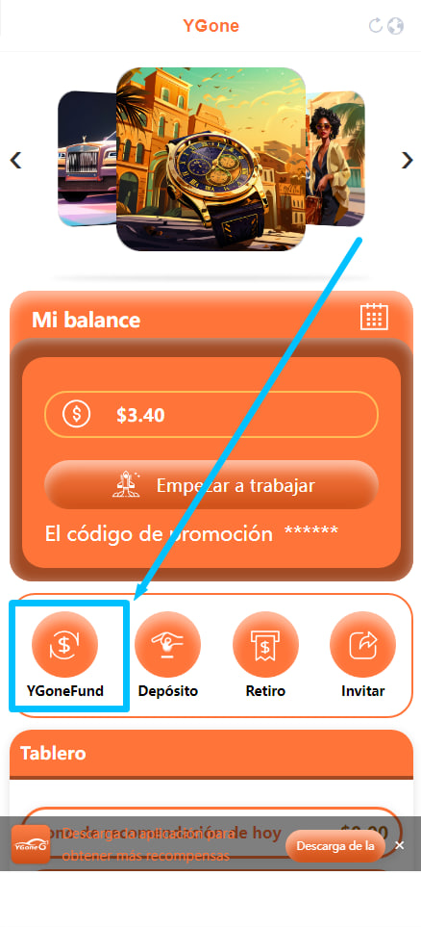
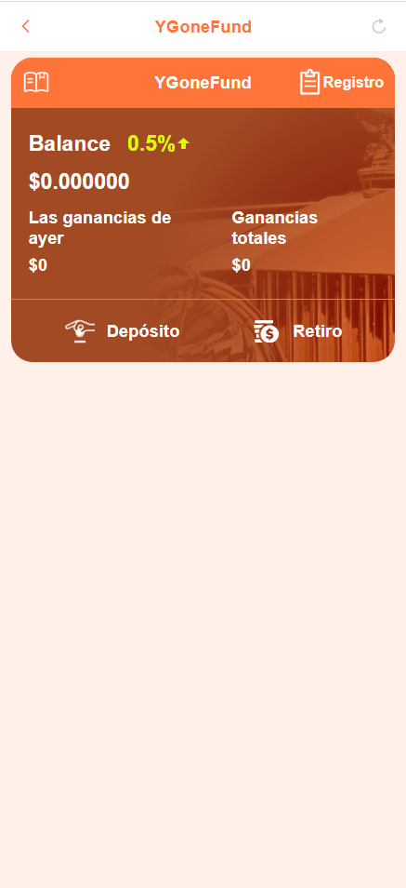
YGone Fund
1. The funds in the YGone work account can be transferred to the YGone fund at any time, and can also be transferred to the YGone work account at any time.
2. YGone fund withdrawal time is from Monday to Friday, and it will arrive in your withdrawal account within 72 hours.
Open the YGone homepage and click on YGone Fund.

Slide 2
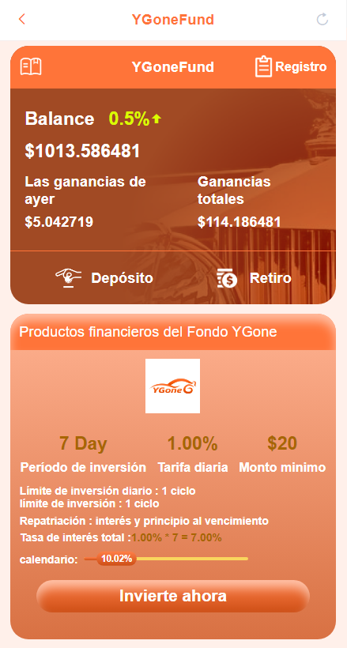
YGone Fund financial products
YGone Fund 7-day 20USD financial product: It can generate 1% income for you every day. The principal and interest will be repaid in full after 7 days. This income is 21.4USD.
YGone Fund 7-day 100USD financial product: It can generate 1% income for you every day. The principal and interest will be repaid in full after 7 days. This income is 107USD.
YGone Fund 30-day 20USD financial product: It can generate 1.5% income for you every day. After 30 days, the principal and interest will be repaid in full. This income is 29USD.
YGone Fund 30-day 100USD financial product: It can generate 1.5% income for you every day. After 30 days, the principal and interest will be repaid in full. This income is 145USD.
YGone Fund financial products can be purchased once a month. After the investment is completed that month, each financial product of YGone Fund will generate investment shares in the second month! This is an additional benefit that YGone provides to all employees. Let us look forward to YGone launching more financial products so that YGone employees can truly enjoy the fun of the Internet!

Slide 3
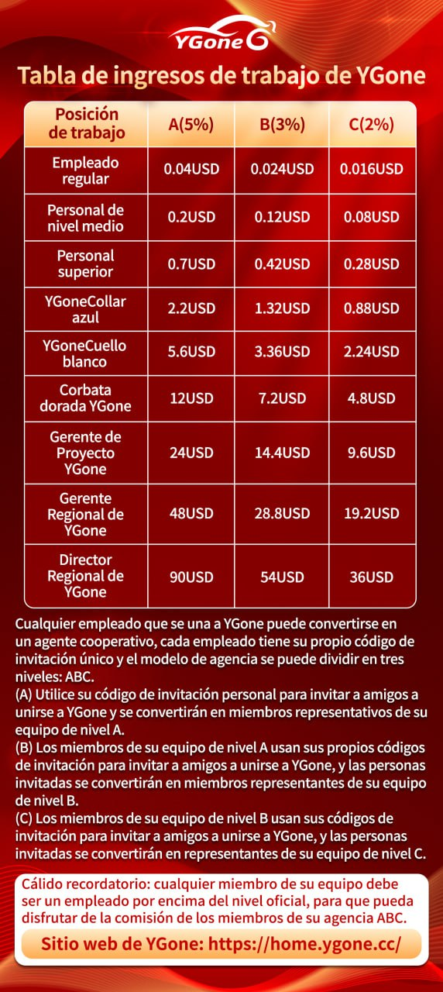
3 :YGone Partner Agent Rewards
Any employee who joins YGone can become a cooperative agent. Each employee has his own unique invitation code, and the same applies to the friends you invite! The agency model can be divided into three levels: ABC.
(A) Use your personal invitation code to invite friends to join YGone, and they will become representative members of your A-level team.
(B) Your A-level team members use their own invitation codes to invite friends to join YGone, and the invited people will become your B-level team representative members.
(C) Your B-level team members use their own invitation codes to invite friends to join YGone, and the invited people will become representative members of your C-level team.
Also as a team leader you can earn agency commissions. You can earn 5% commission on the work of your A-level employees. You can earn 3% commission on the work of your B-level subordinates. You can earn a 2% commission on the work of your C-level subordinates. Any member of your team must be an employee at a formal level or above, so that you can enjoy the commission of your ABC agent member. This is the cooperative agent of YGone, which is beneficial to the development of each of us. We can use our hands to create our own wealth!

